Slide 1


Contrastive Label Enhancement
Yifei Wang, Yiyang Zhou, Jihua Zhu,
Xinyuan Liu, Wenbiao Yan, and Zhiqiang Tian
School of Software Engineering, Xi’an Jiaotong University

Slide 2

Label Ambiguity
When multiple labels are associated with the same instance, their importance is unlikely to be equal.
SLL
Mountain
single-label
MLL
Mountain, Sky, People
multi-label
degree
LDL
label distribution
label
Mou
Sky
Peo

Slide 3
Label Distribution
SLL and MLL:
Which label can describe the instance?
LDL:
How much does each label describe the instance?
degree
The annotation process is high-cost and time-consuming.
The annotation process is difficult to objectively measure
Label Enhancement
(LE)
label
Mou
Sky
Peo

Slide 4
Label Enhancement
Label Enhancement (LE) effectively recovers label distributions by leveraging logical labels and the implicit information within the given features.

Slide 5
Previous Work
KM ( The Kernel-Based Label Enhancement)
Main idea：maps each instance to a high-dimensional space and uses a kernel function to calculate the distance between samples and the center of the group to recover the label distributions.
GLLE (Graph Laplacian Label Enhancement)
Main idea：utilizes the topological information of the feature space and the correlations among the labels to recover the label distributions.
LEVI (LE with Variational Inference)
Main idea：treats the label distributions as latent vectors and utilizes variational inference to infer the label distributions from logical labels.
LESC (LE with Sample Correlation)
Main idea：uses low-rank representations to excavate the underlying information contained in the feature space.
Limitation
Without considering the essential connection between features and logical labels. Actually, Features and labels are descriptions of two different dimensions related to the same samples.

Slide 6
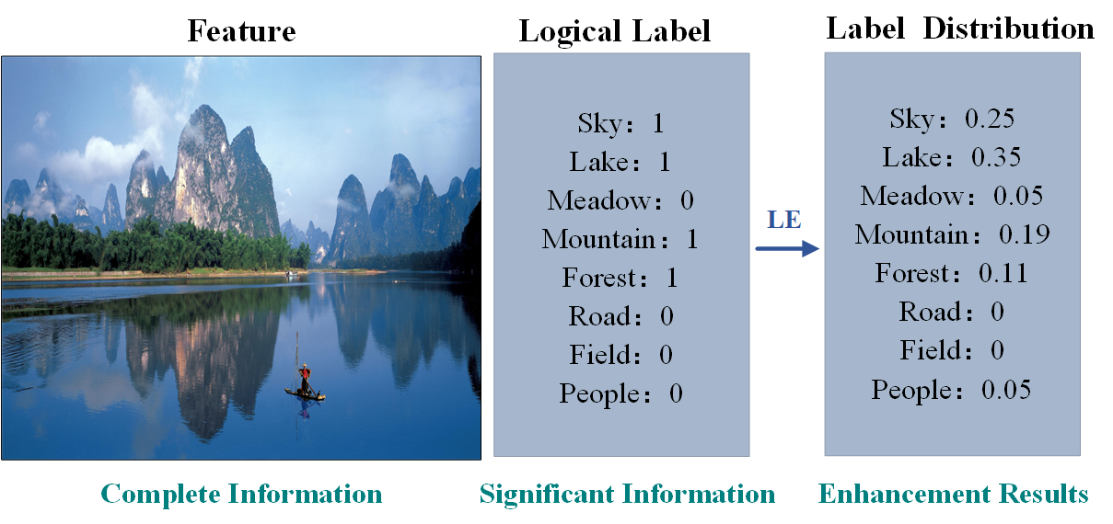
Motivation
Feature <--> Label
Features contain the full information of samples with many redundancies, while logical labels possess significant information but are not comprehensive.
Features and logic labels can be seen as two different views related to the same samples.

Slide 7
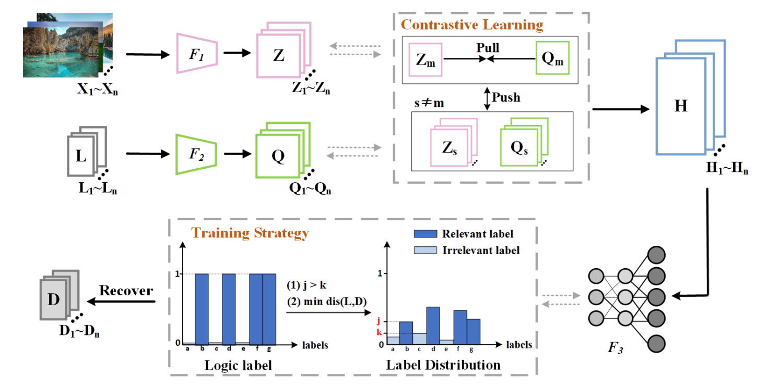


Framework
The Generation of High-Level Features by Contrastive Learning Features.
The Training Strategy With Label-Level Consistency for LE.

Slide 8
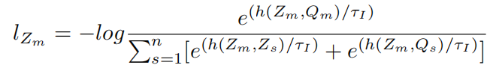
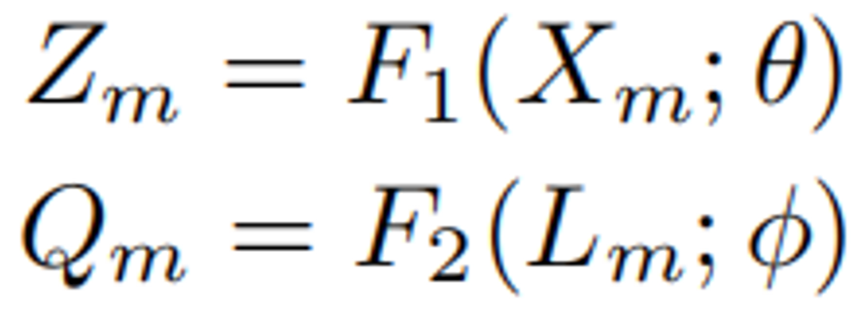
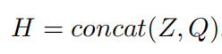
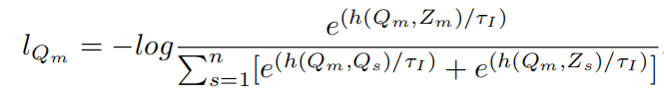
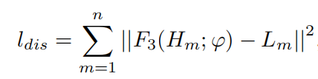
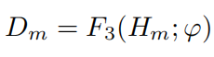
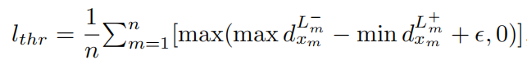
Framework
The Generation of High-Level Features by Contrastive Learning
The Training Strategy With Label-Level Consistency for LE

Slide 9
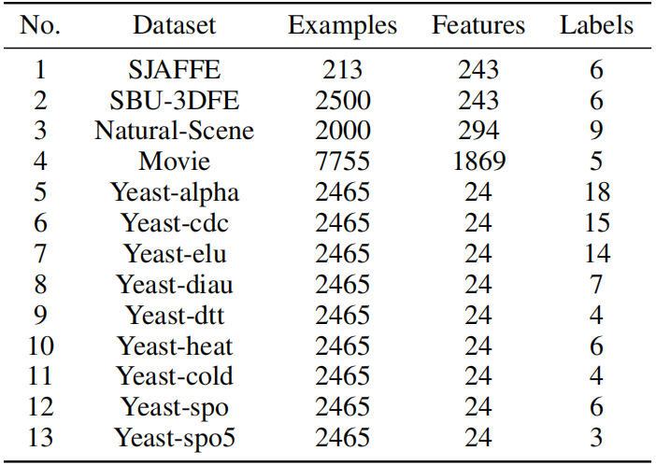
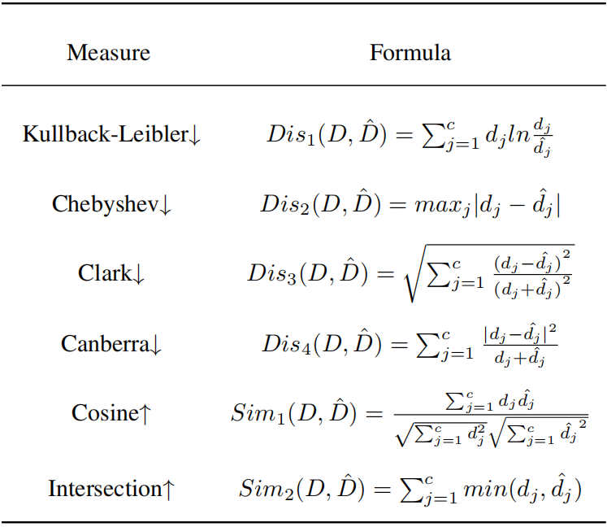
Experiments
Datasets
Measures
We conduct comprehensive experiments on 13 real-world datasets to verify the effectiveness of our method.
We employ six measures based on the distance or similarity between the recovered label distributions and the actual label distributions to assess the recovery performance.

Slide 10
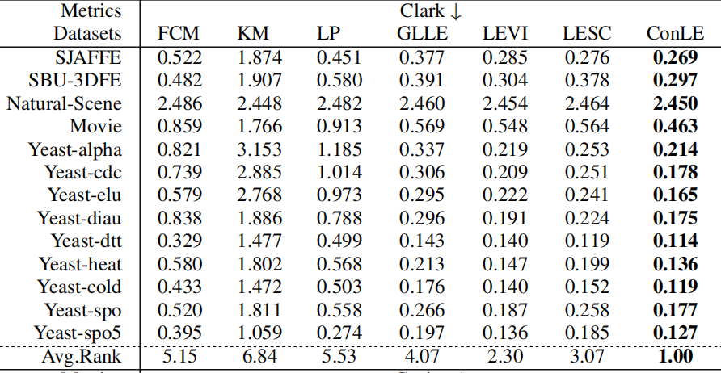
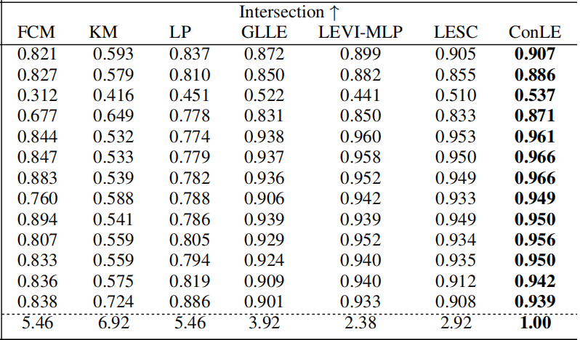
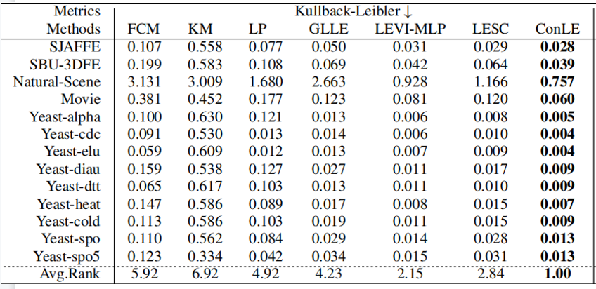
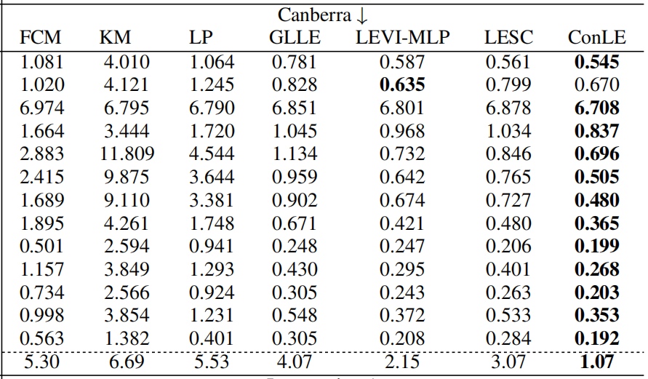
Experiments
Comparison Experiments
The experimental results clearly indicate that ConLE exhibits superior recovery performance compared to the other advanced LE algorithms and it obtains excellent performance both on large-scale datasets and small-scale datasets.

Slide 11
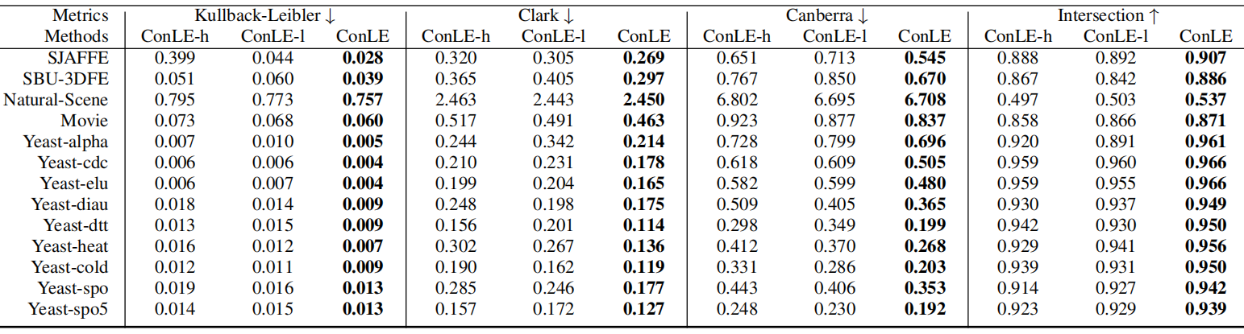
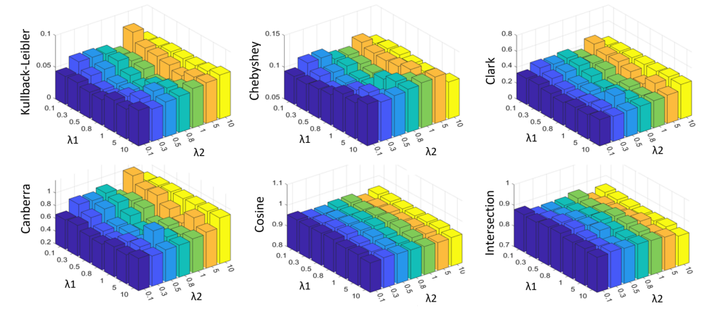
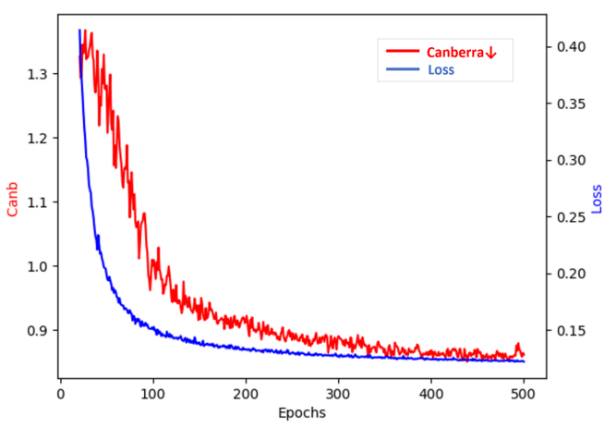
Experiments
Ablation Studies
Parameters Sensitivity
Convergence Analysis

Slide 12
Conclusion
We propose Contrastive Label Enhancement (ConLE), a novel method to cope with the LE problem.
ConLE regards features and logic labels as descriptions from different views, and then elegantly integrates them to generate high-level features by contrastive learning. Additionally, ConLE employs a training strategy that considers the consistency of label attributes to estimate the label distributions from high-level features.
Experimental results on 13 datasets demonstrate its superior performance over other state-of-the-art methods.

Slide 13
Thank you

